Slide 1
Wasail
Fatima Ali Tirmizi, Fizza Adeel,
Irtaza Ahmed Khan, and Malaika Sultan

Slide 2
Problem Statement
Inadequate communication between vendors and grocery stores, along with imprecise inventory orders, hampers food supply chain efficiency.
Grocery Stores
Inventory Mismanagement
Conventional Procurement Structure
Communication Issues
“Mobiler”
Vendors
Small Customer Base
Labour Intensive Processes
Information Gaps

Slide 3
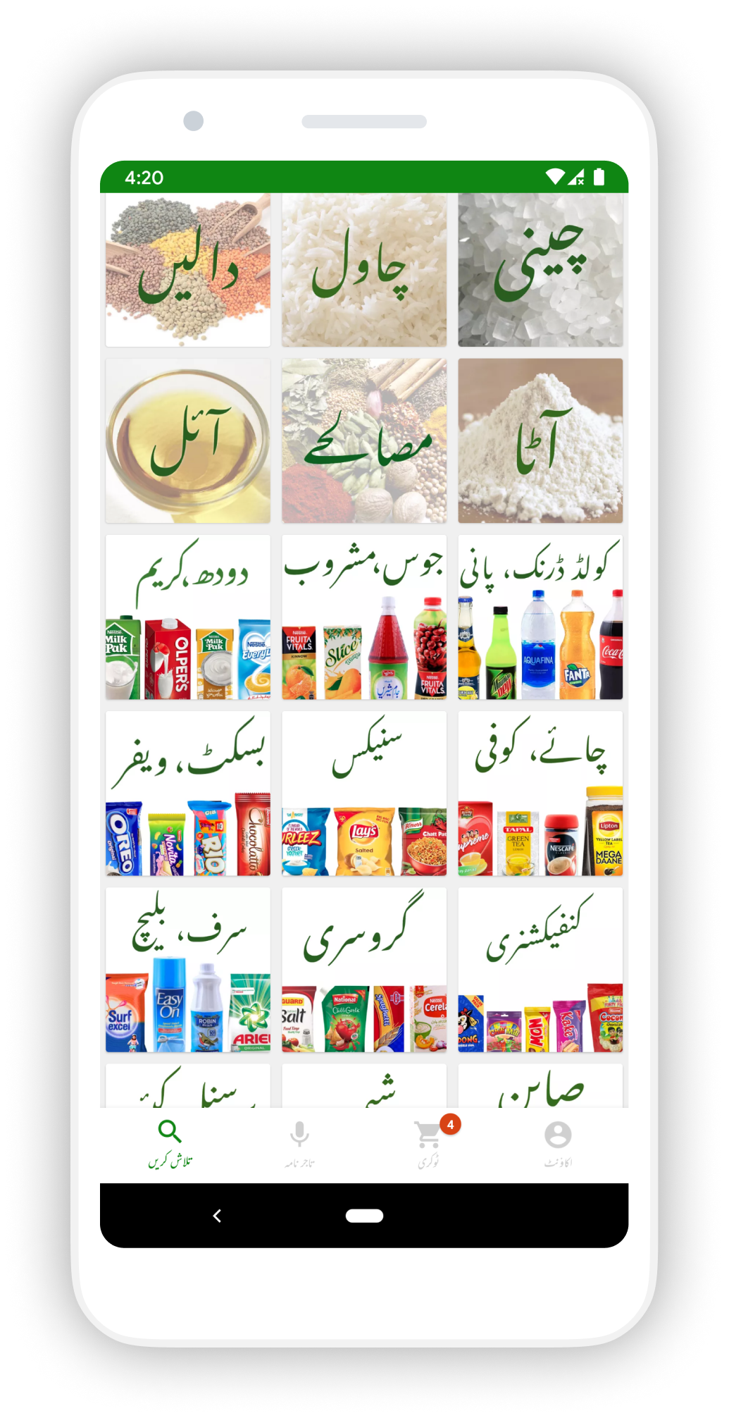
Existing System
Findings from interviews conducted
Discounts on products close to expiration
Product Monopolization
Only source to new products is through vendors
Tajir
Inventory Purchasing Application

Slide 4


Literature Review
Automation Boosts Supermarket Performance
Revolutionise Demand Forecasting Technique
Insights from Industry
Case Study: Corporacion Favorita in Ecuador
Shelf Engine & Guac

Slide 5
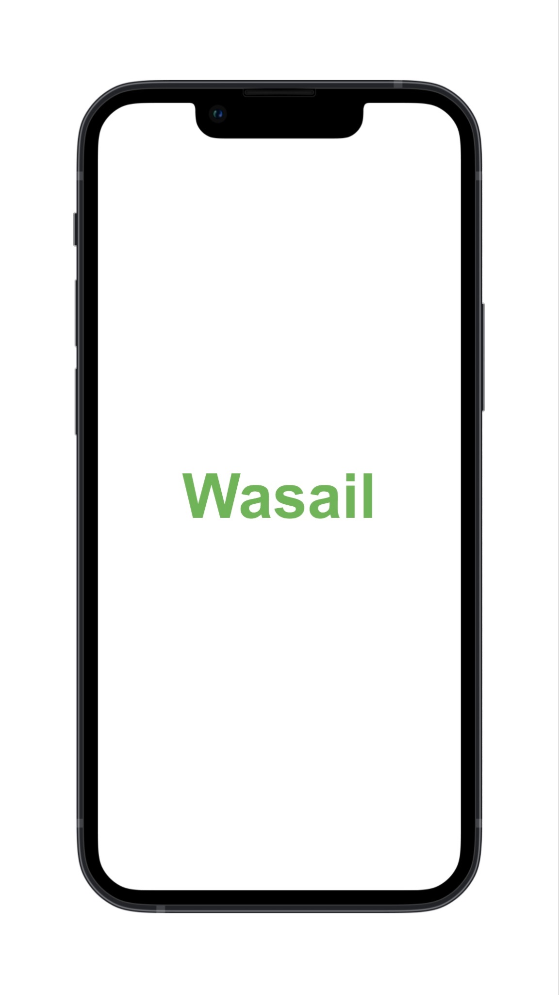
Proposed Solution
Bridging the gap between vendors and grocery stores while predicting the perfect amount to order.
Authentication and Discoverability
Forming Connections
Demand Forecasting
Order Placement and Tracking

Slide 6
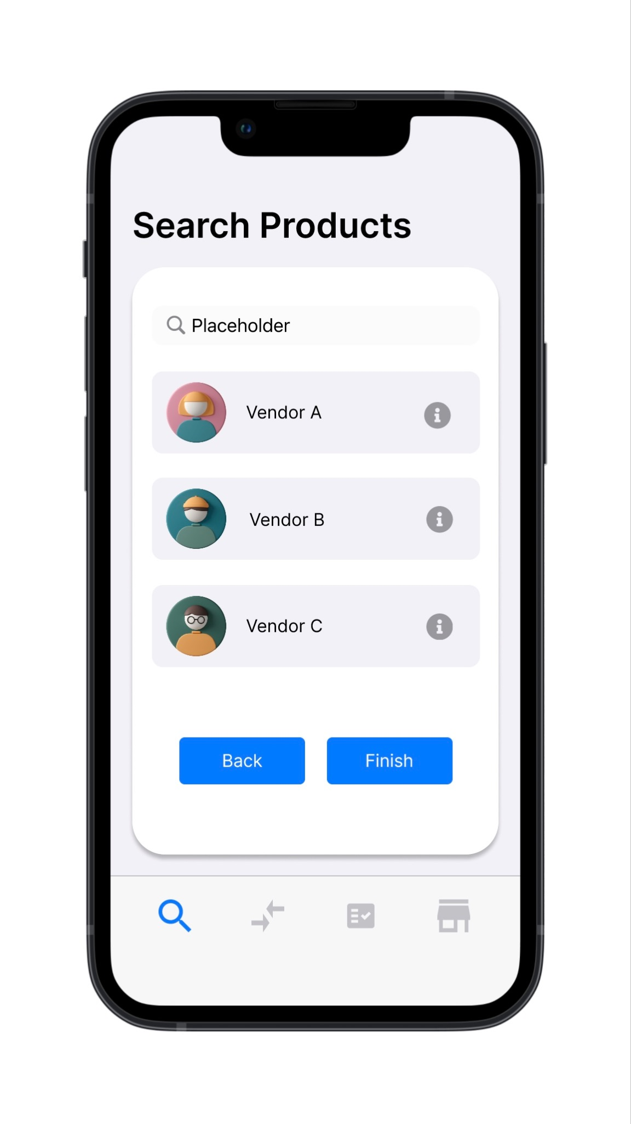
Authentication and Discoverability
Authentication:
Submit Personal Information
Upload ID Card
Verification Process
Discoverability:
Search Product
Vendor Listings

Slide 7
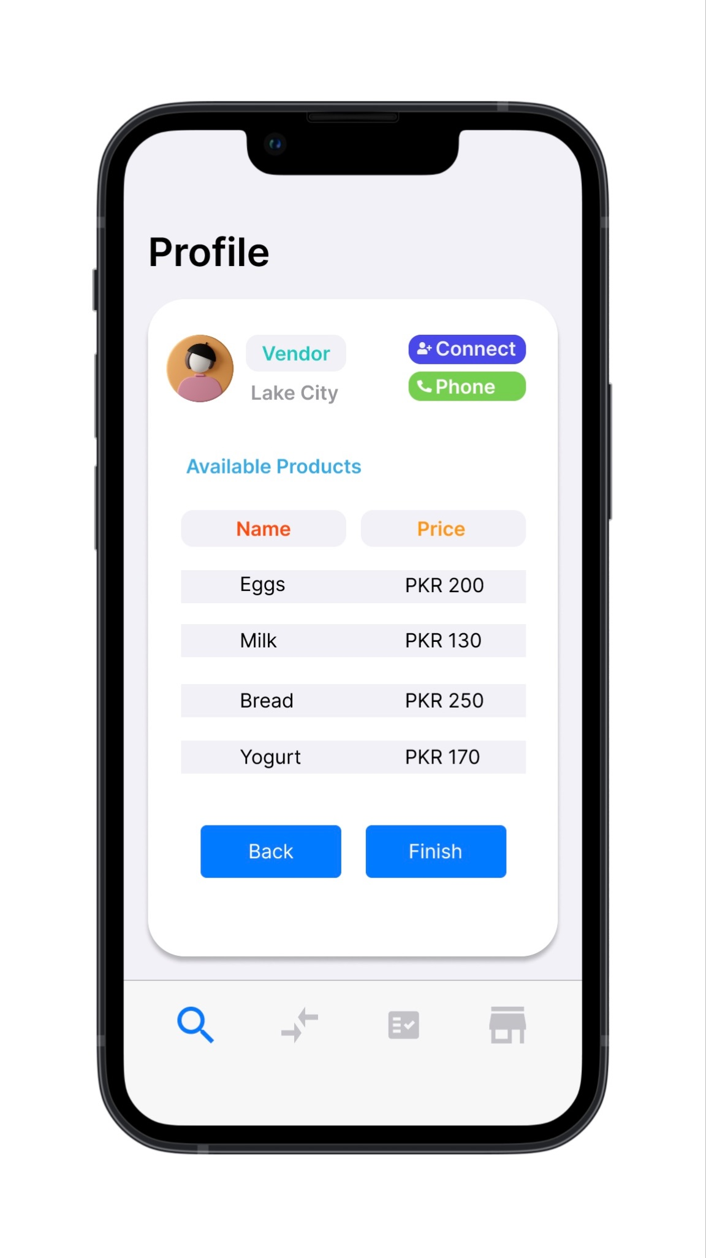
Forming Connections
User Accounts
Product Listings
Connection Request
Store/Vendor List

Slide 8
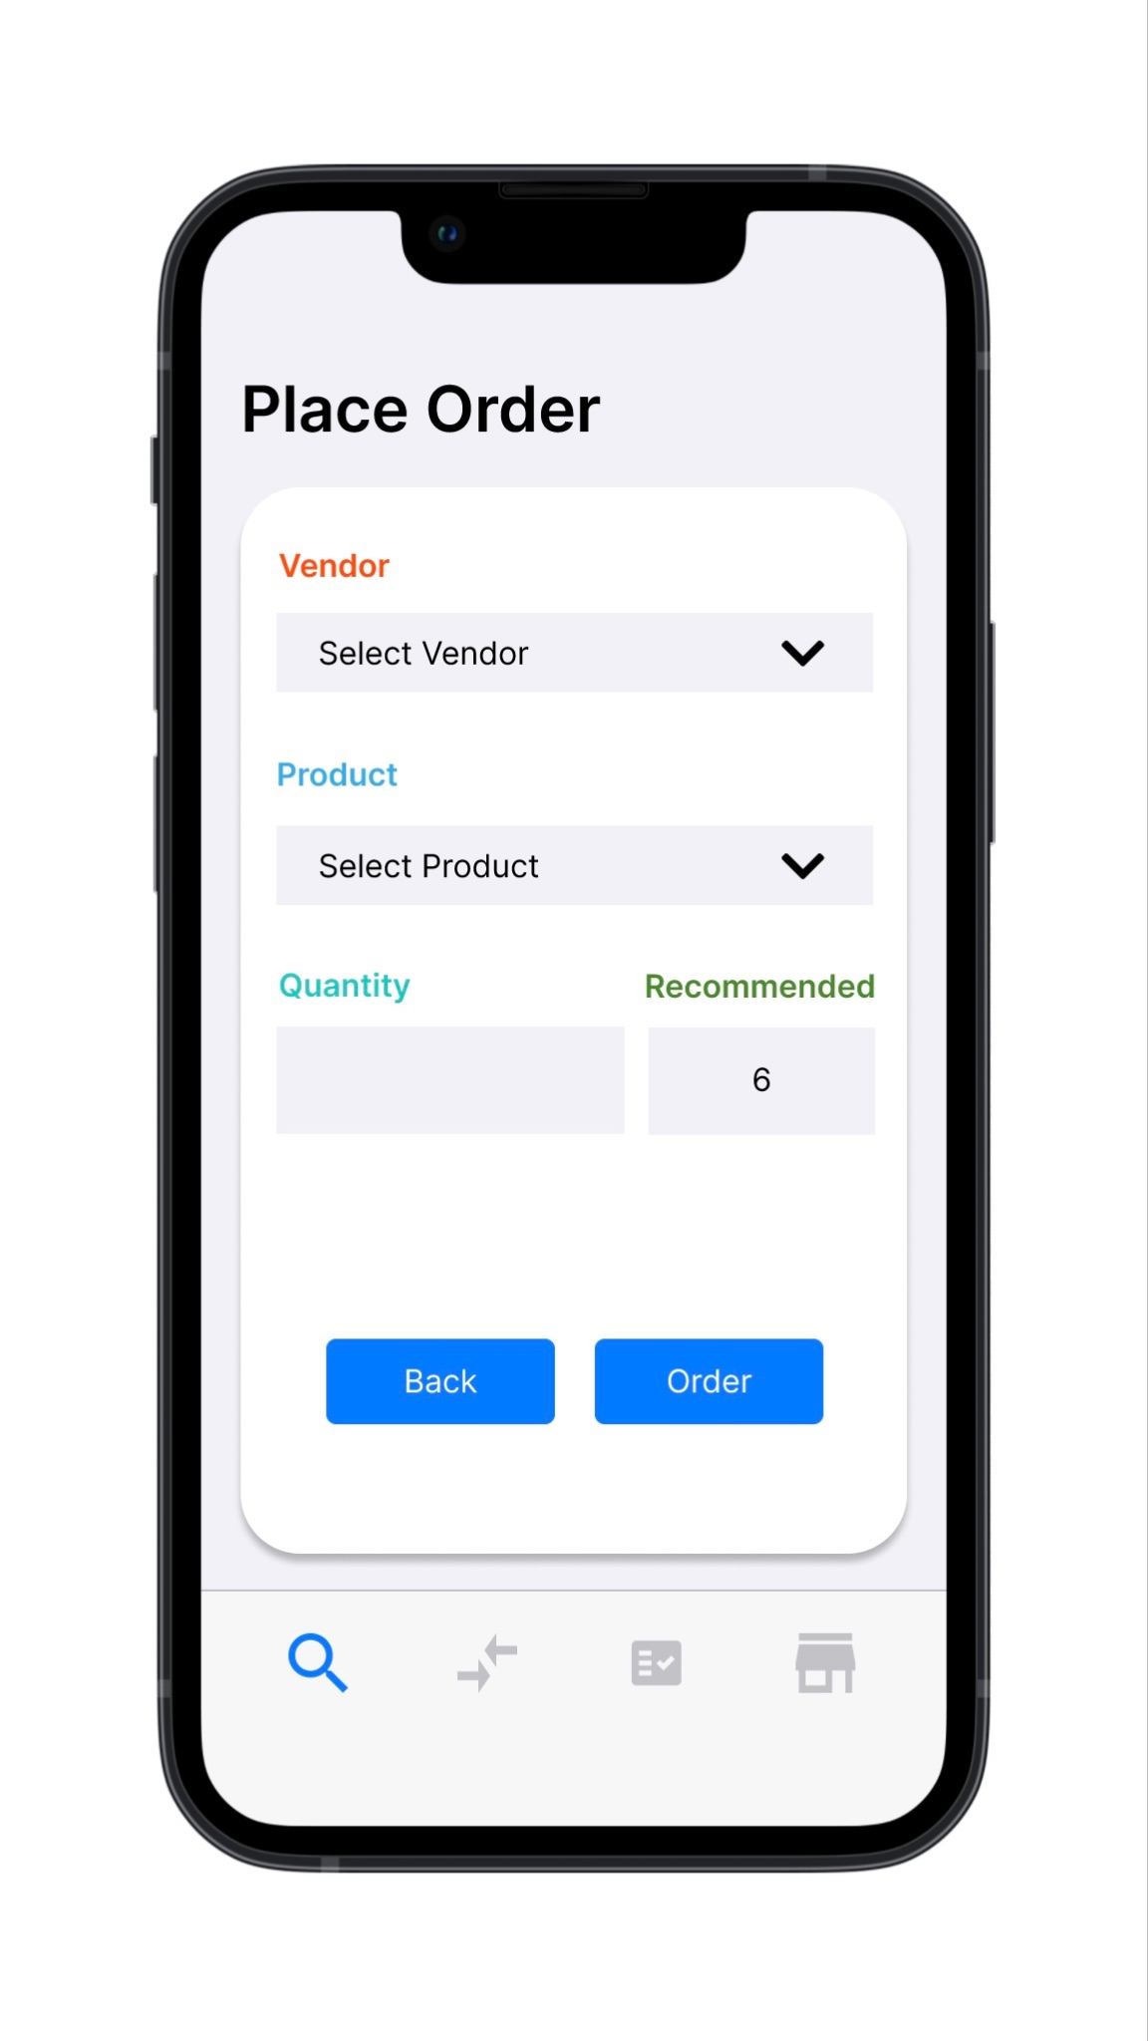
Demand Forecasting
Data Collection
Cleaning and Feature Engineering:
Demand Trends
Factors i.e. Holidays, Weather, Traffic, and Housing Prices
Machine Learning
Neural Networks and Deep Learning
Order Recommendation

Slide 9
Order Placement and Tracking
Order Placement
Vendor Selection
Product Selection
Quantity Selection
Order Tracking
Order Queue
Live Delivery Tracking

Slide 10
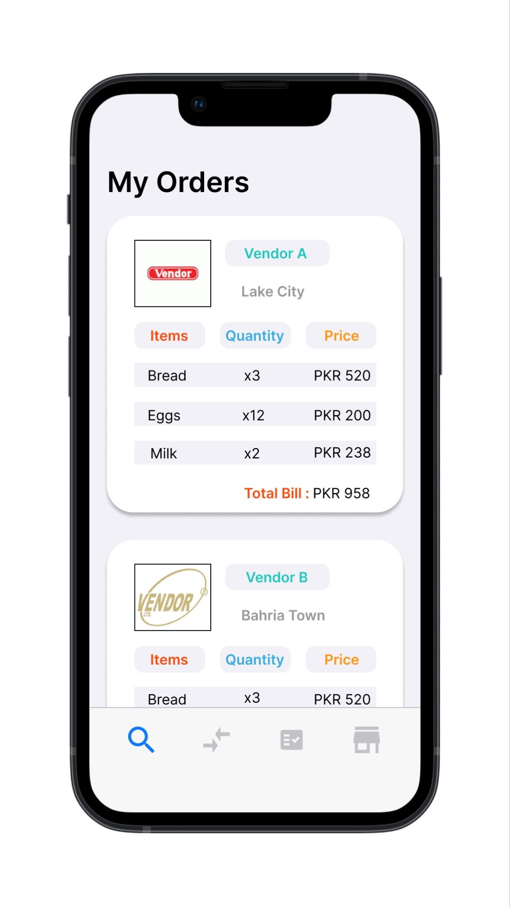
Order Placement and Tracking
Order Placement
Vendor Selection
Product Selection
Quantity Selection
Order Tracking
Order Queue
Live Delivery Tracking

Slide 11
Deliverables
Dataset Grocery Stores, Vendors, and Pharmacies
App Grocery Stores / Vendors
Website Admin Portal
ML Model Demand Forecasting
REST API Frontend & Backend Communication
Database Data Storage

Slide 12
Technologies
Front-End
JavaScript / React
Back-End (REST API)
Java / Spring Boot
Mobile Development:
Dart / Flutter
Machine Learning:
Python
Cloud Services:
Google Cloud
Data Storage:
MySQL
Version Control:
GitHub
Project Management:
Jira
Collaboration:
Discord

Slide 13
Business Model
Advertising and Promotion Revenue Stream
Product Promotion:
Showcase Products Prominently (Vendors)
Feature in Dedicated Sections, Banners, or Listings
Sponsored Product Listings
Monetization:
Charge for Premium Product Placements
Implement Pay Per Click (PPC) or Pay-Per-Impression (PPI) Model
Revenue from Sponsored Listings and Banners

Slide 14
Project Methodology
Project Initiation (Week 1-5)
Requirement Gathering (Week 6-9)
System Design (Week 9-12)
Development (Week 13-36)
Testing and Quality Assurance (Week 15-36)
Deployment (Week 36-38)
Maintenance (Ongoing)

Slide 15
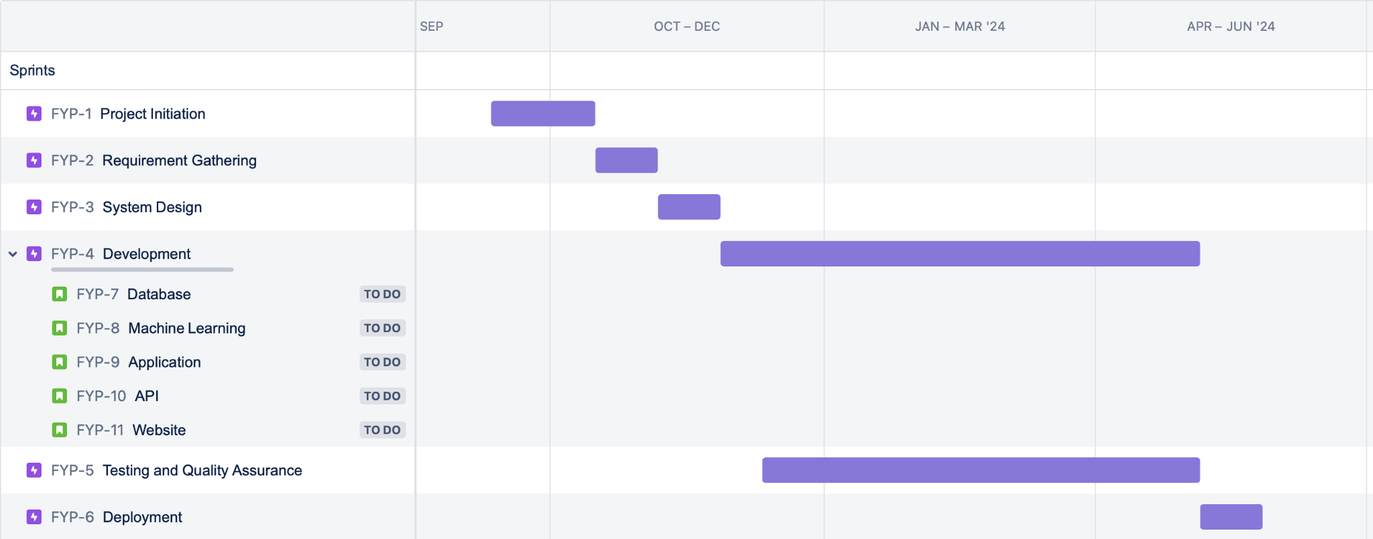
Timeline

